Slide 1
Predictive Maintenance of Industrial Machinery
CAPSTONE PROJECT
Presented By:
1. Tarun Jayant V M - Sri Ramakrishna Engineering College - CSE

Slide 2
OUTLINE
Problem Statement
Proposed System/Solution
System Development Approach
Algorithm & Deployment
Result (Output Image)
Conclusion
Future Scope
References

Slide 3
Problem Statement
Industrial machinery is prone to sudden failures such as tool wear, overheating, and power disruptions, leading to unplanned downtime and costly repairs. Predictive maintenance strategies aim to anticipate these failures by analyzing operational data, allowing maintenance before failure occurs. However, identifying patterns across various failure types remains a challenge due to complex multi-class classification requirements and real-time data variability.

Slide 4
Proposed Solution
The proposed system aims to address the challenge of predicting potential failures in industrial machines to ensure proactive maintenance and minimize downtime. This involves leveraging machine learning techniques to classify different types of machinery failures based on real-time operational sensor data. The solution will consist of the following components:
1) Data Collection:
Gather historical sensor data from industrial machines, including parameters like torque, rotational speed, tool wear, and machine failure labels.
Utilize real-time operational logs from industrial environments to enrich the dataset and simulate realistic failure conditions.
2) Data Preprocessing:
Clean and preprocess the dataset to handle missing values, anomalies, and outliers to improve model performance.
Use automated feature selection and transformation via IBM Watsonx.ai to identify relevant features contributing to failure prediction.
3) Machine Learning Algorithm:
Implement a multi-class classification model using Snap Random Forest (Batched Tree Ensemble Classifier) automatically selected by IBM Watsonx.ai.
Consider all failure types such as Tool Wear, Heat Dissipation, Overstrain, Power Failure, Random Failures, and No Failure to ensure complete fault coverage.
4) Deployment:
Use IBM Watsonx.ai pipelines to generate, evaluate, and rank model candidates with minimal manual effort.
Export the best-performing model pipeline for potential deployment in edge systems, dashboards, or cloud monitoring solutions for real-time failure prediction.
5) Evaluation:
Evaluate model performance using ROC curve, confusion matrix, and precision-recall metrics.
Achieved 99.7% accuracy using holdout validation in IBM Watsonx.ai

Slide 5
System Approach
System Requirements:
IBM Cloud Account (Lite Plan) Used to access IBM Watsonx.ai Studio for building the model.
IBM Watsonx.ai Studio Environment Resource Usage
1 vCPU + 4 GB RAM → 0.5 capacity units
2 vCPU + 8 GB RAM → 1 capacity unit
4 vCPU + 16 GB RAM → 2 capacity units
A cloud-based visual AI development tool used to create and train the AutoAI pipelines for multi-class classification.
CSV Dataset from Kaggle The predictive maintenance dataset containing sensor values and failure types was used as the input data source.
Libraries Required to Build the Model:
Although AutoAI automates model development without needing to manually import libraries, it internally uses the following:
Pandas & NumPy For internal data handling, transformation, and feature extraction.
Scikit-learn For model training, validation, and metrics (confusion matrix, ROC, precision-recall).
Snap ML (IBM’s Accelerated Library) For fast and efficient training of ensemble models like the Batched Tree Ensemble Classifier.
Matplotlib / Seaborn (Visuals) Used by Watsonx.ai to generate visual outputs like ROC curves, confusion matrices, and precision-recall plots.

Slide 6
Algorithm & Deployment
Algorithm Selection:
IBM Watsonx.ai AutoAI selected the Batched Tree Ensemble Classifier (Snap Random Forest), optimized for high accuracy and fast training on structured, tabular sensor data.
This algorithm is suitable for multi-class classification, effectively distinguishing different types of machine failures.
Data Input:
Input features include rotational speed, torque, tool wear, and operational settings.
The target output is the type of failure, such as Tool Wear, Power Failure, or No Failure.
Training Process:
The Watsonx.ai AutoAI engine automatically performed data preprocessing, feature engineering, and model tuning.
Multiple models were trained and ranked using holdout validation, selecting the pipeline with 99.7% accuracy.
Prediction Process:
The final model predicts the specific failure category based on live sensor inputs.
It supports real-time prediction and can be integrated with dashboards or alerts for maintenance teams.
Deployment:
The trained model pipeline from IBM Watsonx.ai was exported and deployed as a REST API via IBM Cloud. It can now be integrated into industrial systems for real-time failure prediction and alerting.

Slide 7
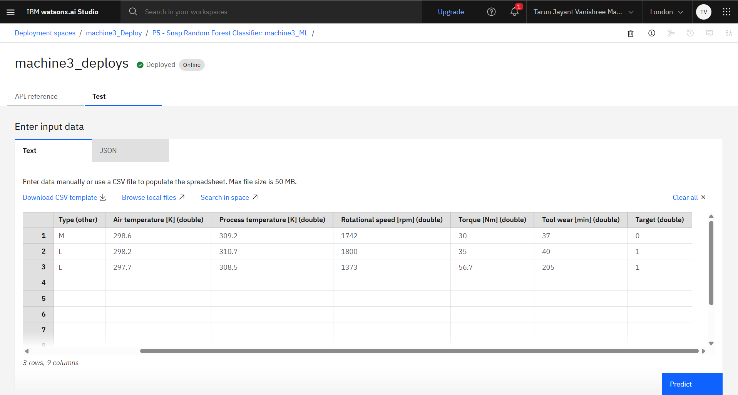
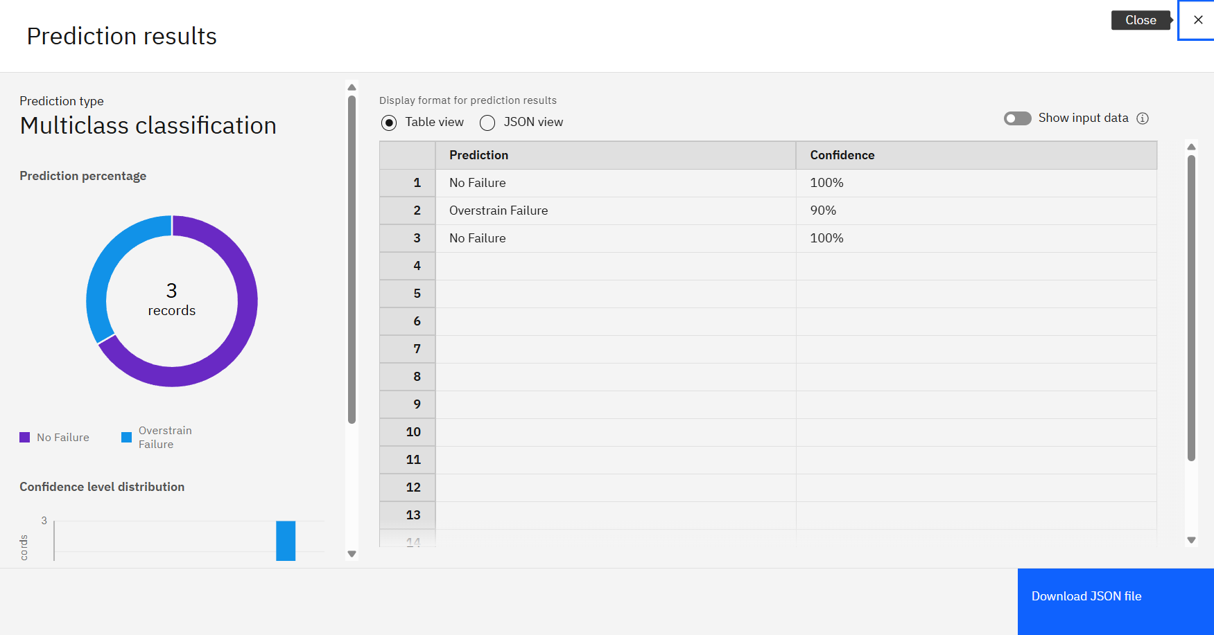
Result

Slide 8
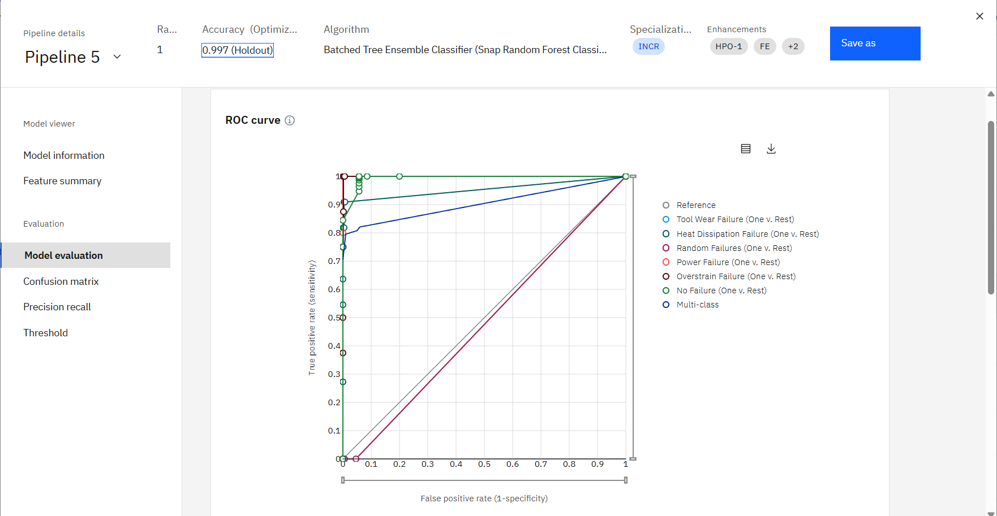
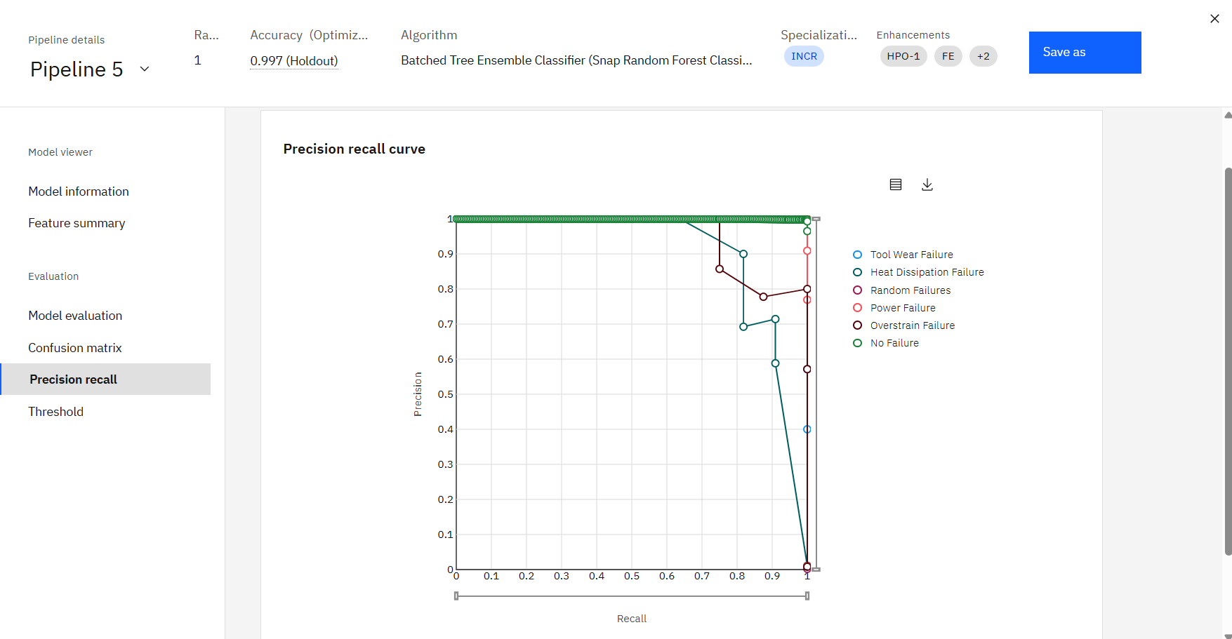
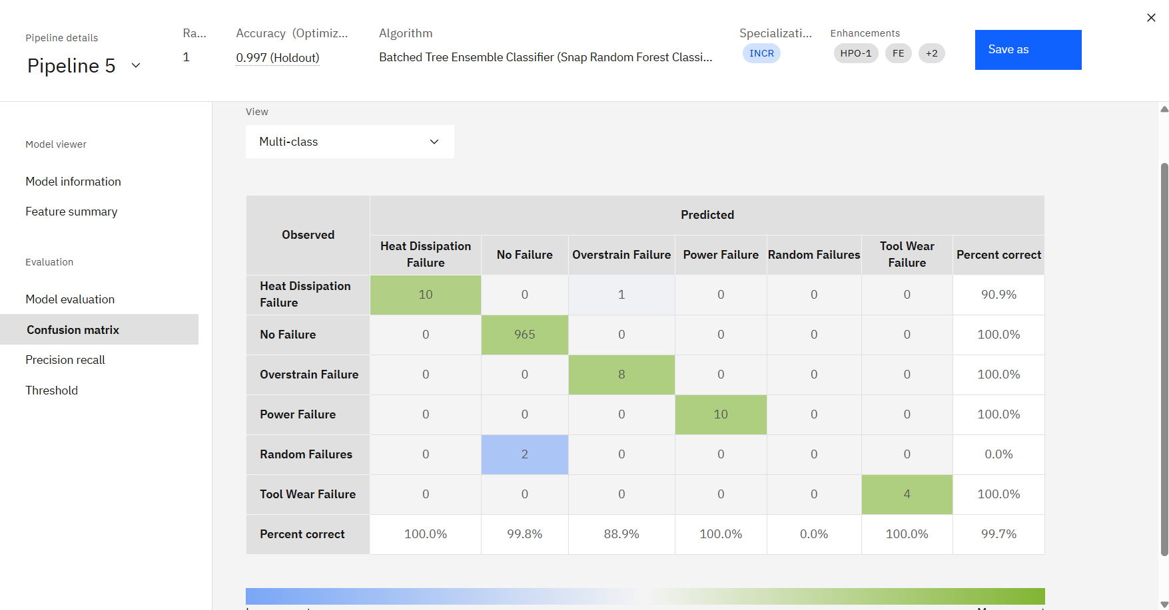
Result
ROC Curve Precision-Recall Confusion Matrix

Slide 9
Conclusion
The predictive maintenance model built using IBM Watsonx.ai achieved a high accuracy of 99.7%, effectively classifying various machinery failure types. AutoAI streamlined the process from data preprocessing to model selection, enabling quick and efficient development.
While the model performed well overall, handling imbalanced classes like random failures posed a minor challenge. Future improvements include real-time data integration and model explainability.
Accurate failure prediction plays a vital role in industrial operations by minimizing unexpected breakdowns, reducing downtime, and lowering maintenance costs—ensuring operational continuity and safety in machinery-dependent environments.

Slide 10
Future scope
Incorporate Real-Time Sensor Streams: Integrate live IoT data from industrial machines for continuous monitoring and faster failure prediction.
Enhance Data Diversity: Include additional contextual data like environmental conditions, usage frequency, or historical repair logs to improve model robustness.
Optimize Model Performance: Fine-tune the algorithm using advanced techniques like hyperparameter tuning, ensemble stacking, or feature importance analysis for even higher accuracy.
Scale Across Industries: Extend the system to different machinery types and industrial sectors, or deploy it across multiple facilities and regions.
Adopt Emerging Technologies: Explore edge computing for on-device predictions and use deep learning models to improve model transparency and decision-making.

Slide 11
References
Scikit-learn Developers, Model Evaluation: Precision, Recall, F-score, and Support, Scikit-learn Documentation. https://scikit-learn.org/stable/modules/model_evaluation.html
Snap ML – IBM Research, Accelerated Machine Learning Library for Cloud and Edge. https://snapml.readthedocs.io
Shivam Bansal, Machine Predictive Maintenance Dataset, Kaggle.
https://www.kaggle.com/datasets/shivamb/machine-predictive-maintenance-classification
IBM Documentation, AutoAI in Watsonx.ai Studio, IBM Cloud Docs. https://www.ibm.com/docs/en/cloud-paks/cp-data/4.6.x?topic=tools-autoai

Slide 12
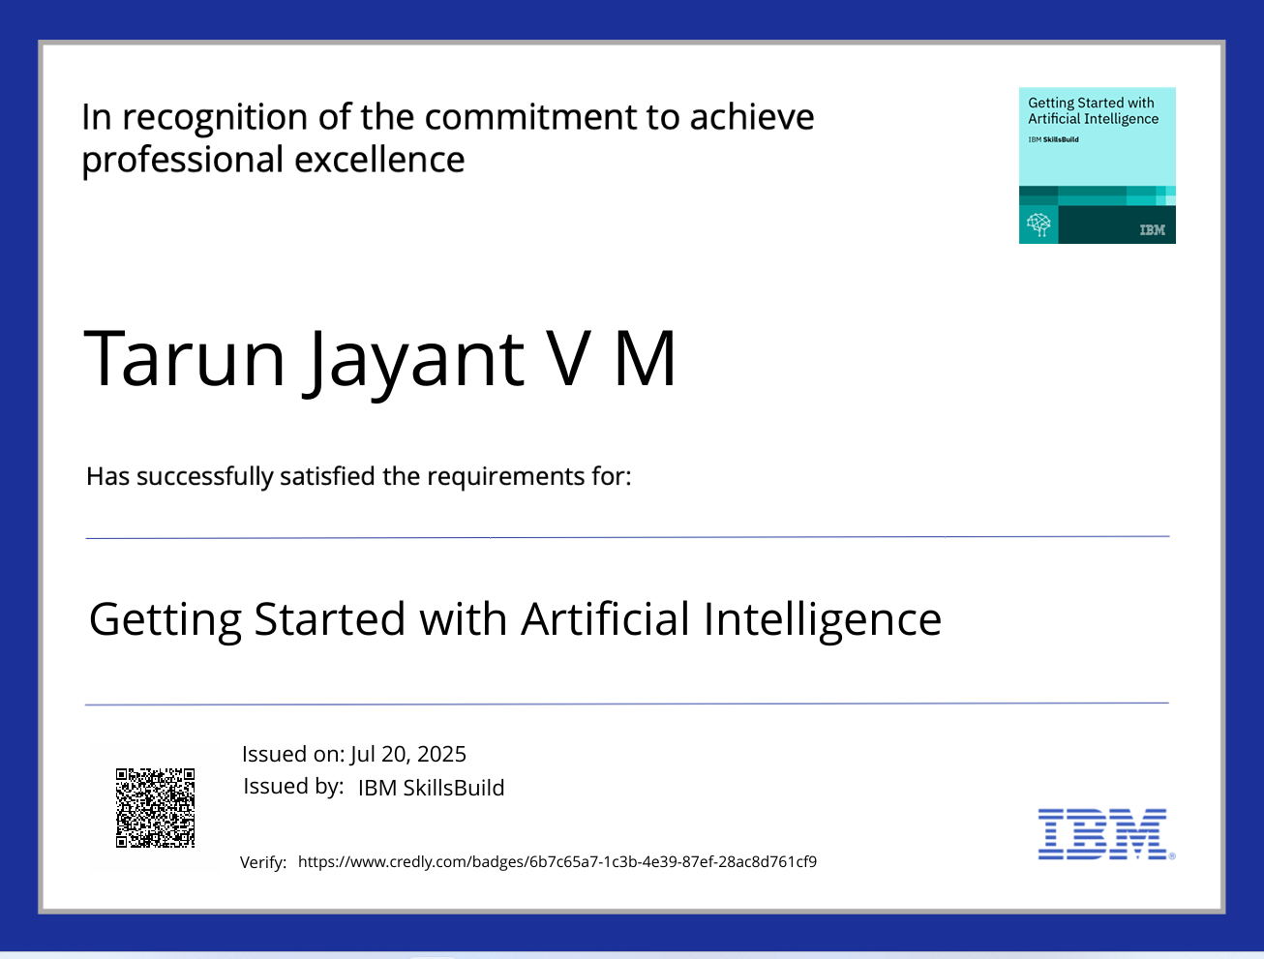
IBM Certifications

Slide 13
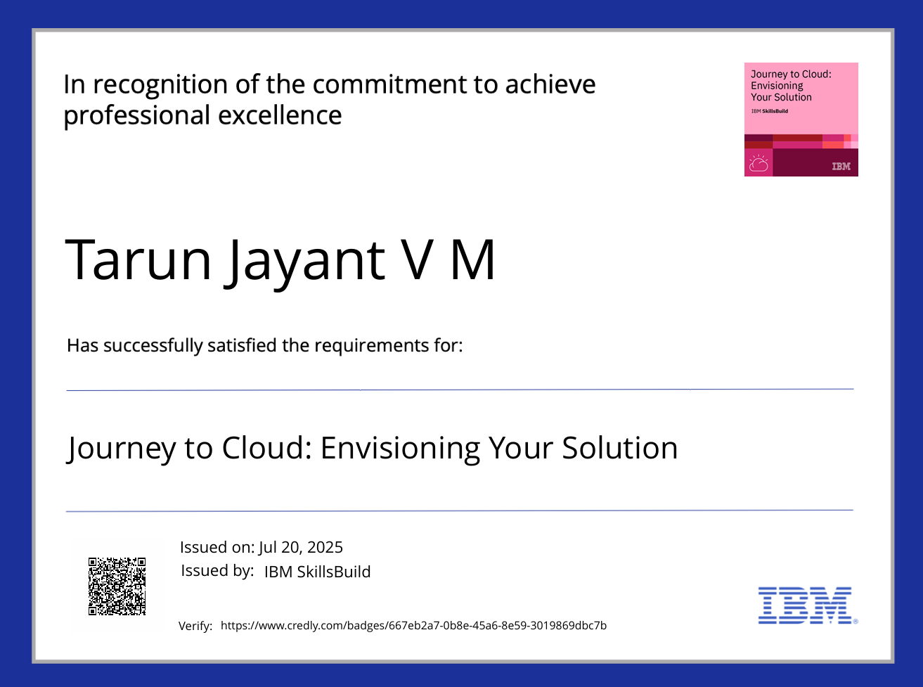
IBM Certifications

Slide 14
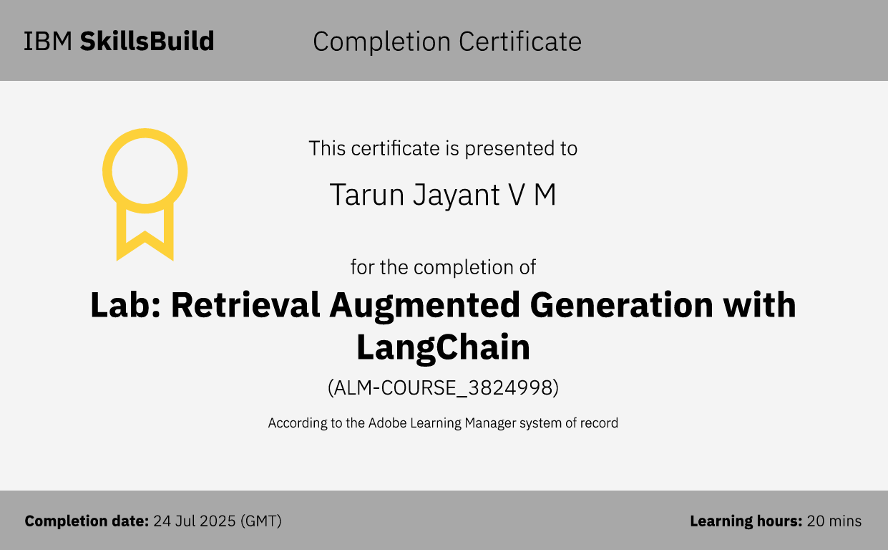
IBM Certifications

Slide 15
THANK YOU

